Slide 1

Capstone Project : Regression Analysis for Predicting Video Game Sales
An examination into the effect of variables on Global Video Sales

Slide 2
Overview of Data & Problem Definition
This project aims to analyze historical video game sales data, identifying trends in genres, platforms, and publishers to inform strategic decisions in the gaming industry.
The dependent variable that will be predicted using multiple linear regression models is total Global Sales.
As the dataset lacks quantitative independent variables, categorical variables like Platform, Genre, and Publisher are converted into numerical variables for regression analysis, considering their high correlation with the dependent variable.

Slide 3
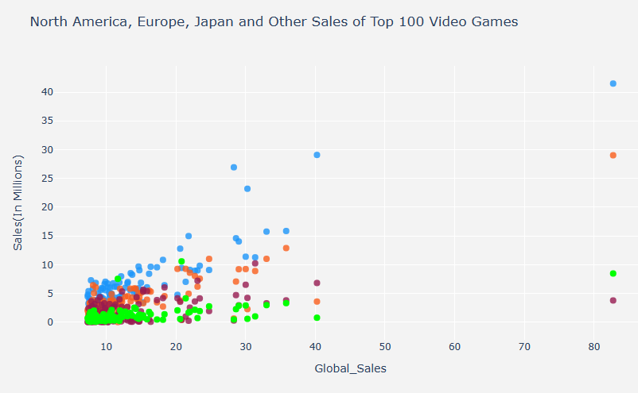

Popularity based on Genre
Action was the most popular genre with the highest number of sales Globally
The second highest was sports. However, the highest grossing game across all markets was Wii Sports. Given this may affect the outcome I removed this as it was an outlier
Wii Sports

Slide 5
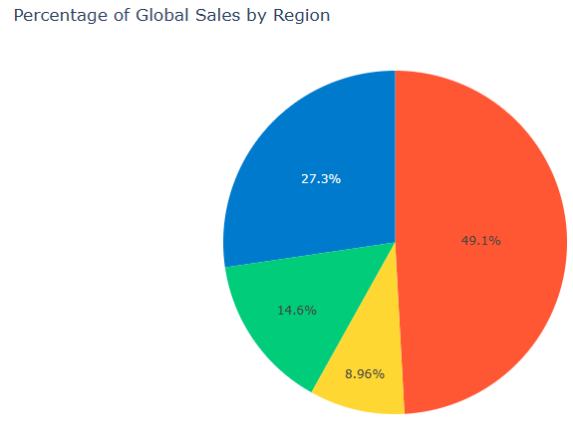

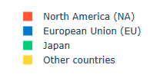
Sales distribution across markets
When looking into multicorrelation The strongest relation between NA_sales (North American/ USA Sales)
Diving into this further we can see that the USA market accounts for nearly half of all Global Sales

Slide 6
Modelling Techniques
Models attempted for this analysis: Multilinear Regression, Principal Component Analysis (PCA), and Partial Least Squares (PLS) Regression.
Comparison of RMSE and R2 values across different models with normalization
Multilinear Regression RMSE: 0.015001624864342897, R2: 0.07397442844946144
PCA Regression RMSE : 0.01674123699336149, R2: 0.09509144293622152
PLS Regression RMSE : 0.016741898509377524, R2: 0.09501992810961701
Comparison of RMSE and R2 values across different models without normalization
Multilinear Regression RMSE: 1.7105964805711504, R2: -0.015022400745020936
PCA Regression RMSE: 2.0668894045476174, R2: -0.00018219613950942737
PLS Regression RMSE: 2.0646621120360353, R2: 0.0019722471705171385

Slide 7
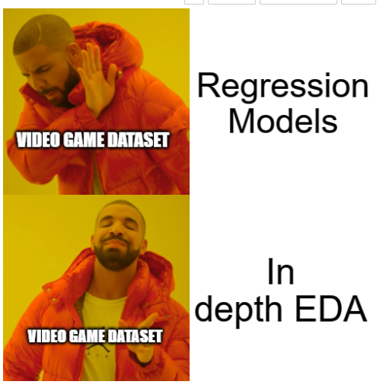
Conclusion & Key Findings
This dataset was definitely more suited to EDA than regressional modelling given the categorical variables.
Through EDA the recommendations are as follows:
Genres such as Action, Sports & Role Play yield consistently high sales
Targeting the US market initially would be the safest given their high percentage of the global gaming market
Sales had the highest peak in 2009 and have steadily been on the decsrese
Regression Findings
Multilinear Regression has better RMSE test scores and the rest of the approaches have very close RMSE test scores. In this respect, Multilinear Regression model appears to be the best model compared to others.

Slide 8

Thank you!

